Slide 1
Safety Orientation
University of Evansville
Department of Chemistry

Slide 2
SAFETY TOPICS
Personal Protection and Proper Attire
Personal Hygiene and Conduct
Proper Handling of Chemicals
Safety Equipment
Emergencies: Injury, Fire, and Spills
RAMP (Principles of Lab Safety)

Slide 3
Personal Protection and Proper Attire

Slide 4
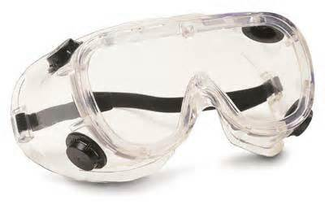
Personal Protection-Goggles
Goggles must be worn at all times in the lab, unless otherwise directed by your lab instructor.
Goggles must be of the approved type; they must be equipped with a splash guard like those illustrated below:

Slide 5
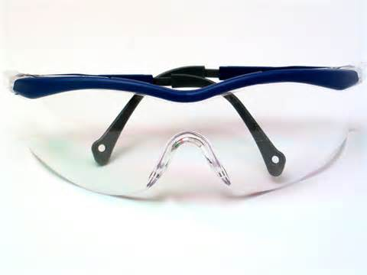
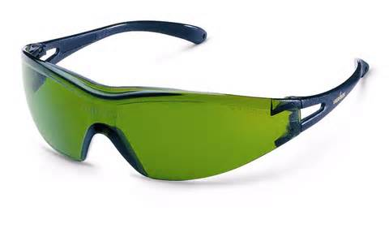
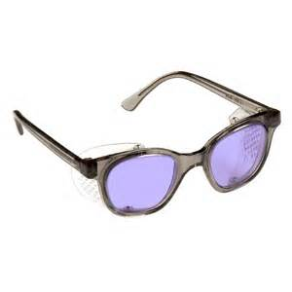
Personal Protection-Goggles
Examples of goggles/glasses that are not acceptable:
Goggles may be purchased from the UE bookstore.
YOU MUST HAVE GOGGLES BEGINNING WITH THE VERY FIRST LAB

Slide 6
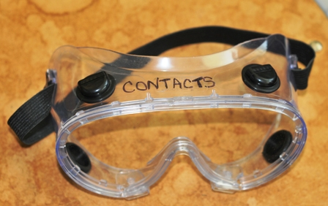
Personal Protection-Goggles & Contacts
If you have no glasses and you must wear contacts, we recommend that you write the word ‘contacts’ on the top of your goggles so that we can respond appropriately in case of an emergency.

Slide 7
Proper Attire-Clothing
Appropriate clothing is required to work in the chemistry lab.
Clothing that covers the majority of your body is necessary to prevent chemicals from coming into contact with your skin.
We do not require a lab coat or lab apron, so it is a good idea to come to lab dressed in old clothes.
Wear clothes (like cotton) that breathes to keep you from overheating.
Do not wear clothing which is loose enough to knock over containers or drag or dip into chemicals or an open flame.

Slide 8
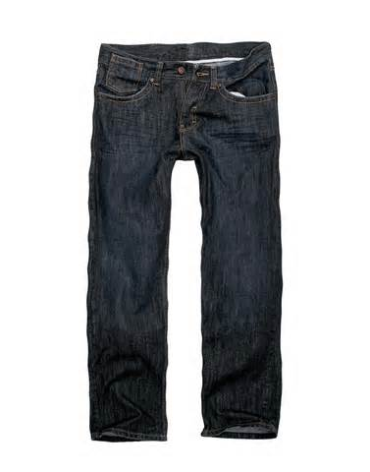
Proper Attire-Clothing
Pants with t-shirts or long-sleeved shirts are required for working in the lab.

Slide 9
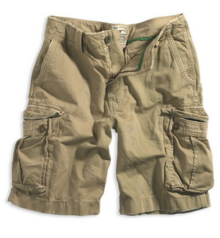
Proper Attire-Clothing
Pants with holes, shorts, short to mid-length skirts, sleeve-less shirts, and tops that expose the mid-riff are not allowed.

Slide 10
Proper Attire-Shoes
Closed-toed AND closed-footed shoes are required. In other words, the entire foot to the ankle must be covered.
In addition, socks must be worn with shoes, so that the entire foot and ankle are not exposed.

Slide 11
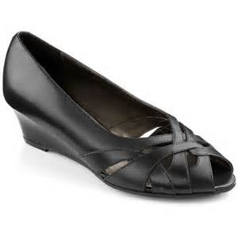
Proper Attire-Shoes
Any shoe that exposes the toes, the heel, or top of the foot are not allowed; so no sandals, clogs, high heels, open-toed shoes, open-footed shoes, or flip-flops are allowed.

Slide 12
Proper Attire-Accessories (e.g. Jewelry)
Wearing accessories, such as jewelry, is not a good idea. We require any accessory that is dangling or flopping be put away before working in the lab.
We do not require you to put away watches or rings, but be mindful of the fact that chemicals may cause damage to these items.

Slide 13
Personal Hygiene and Conduct

Slide 14
Personal Hygiene
Eating, drinking, and smoking are strictly forbidden in the lab.

Slide 15
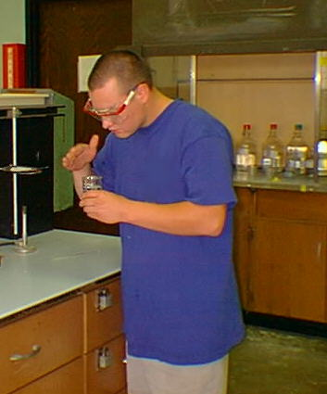
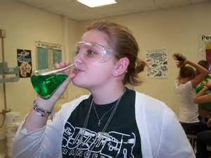
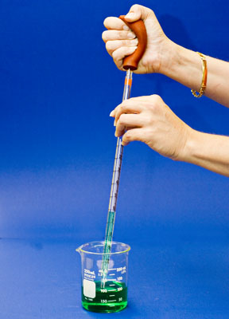
Personal Hygiene
Never taste a chemical directly and check odors only by wafting.
Never mouth pipet—use a pipet bulb.

Slide 16
Personal Hygiene
Keep your work space organized, clean, and uncluttered.
All belongings not being used during an experiment (e.g. coats, backpacks, etc) should be placed in the shelves provided.

Slide 17
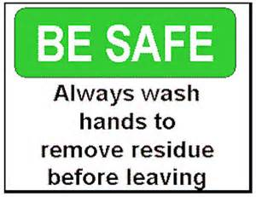
Personal Hygiene
Long hair must be tied back to prevent hair from accidentally falling into a flame or chemical. Also think about the fact that some hair sprays and other hair care products are flammable.
Long hair can also block your vision, which can lead to accidents.
Wash your hands with soap and water before leaving the lab.

Slide 18
Conduct
No horseplay or running. Keep aisles clear and unobstructed.
No music allowed in labs; radios and other entertainment devices are not permitted.
Cell phones are not allowed in the lab, they are a distraction.

Slide 19
Conduct
No unauthorized experiments are to be performed. If you are curious about trying a procedure not covered in the experiment, consult your lab instructor.
Be prepared before you come to lab and read instructions for an experiment ahead of time.

Slide 20
Proper Handling of Chemicals & Equipment

Slide 21
Handling Chemicals
Handle all chemicals carefully and treat them with respect and understand the hazardous nature of the chemicals you are using.
Your instructor will highlight the hazards associated with the chemicals for each experiment.
Additionally, Safety Data Sheets (SDS), which outline hazards and precautions, are available in lab for all chemicals you will use.

Slide 22
Handling Chemicals
Know what chemicals you are using during an experiment. Carefully read (and reread) labels before taking anything from a bottle.
Bottles should be clearly labeled, but if you are uncertain about what it is, ask before taking it.
Take only what you need and no more; if you take too much it is considered waste.

Slide 23
Handling Chemicals
Do not return excess reagents to stock bottles. If you take too much, then treat as waste and dispose of properly.
Do not switch lids or caps on bottles; you risk cross contamination, thereby rendering the reagent as unusable.
Reagent bottles should not be moved and carried to your work area. A proper container may be taken to the reagent bottle to obtain the amount of chemical you need.

Slide 24
Handling Chemicals
Always pour acids into water; never the reverse. If you pour water into an acid, the heat of the reaction will cause the water to explode into steam, sometimes violently, and the acid will splatter.
Never point a heated test tube (or other vessel) at yourself or another person.
Never leave a propane torch unattended. Turn it off when finished. And keep flammable chemicals (e.g. solvents) away from open flames.

Slide 25
Handling Chemicals-Waste
Dispose of waste properly. Waste containers will be provided for each lab and their use explained by your lab instructor.
Waste may not be poured into the sink, unless you are told otherwise.

Slide 26
Handling Chemicals-Waste
Types of waste containers: (some examples)
Organic Solvents
Metal Ion Waste
Halogenated Waste
Non-halogenated Waste

Slide 27
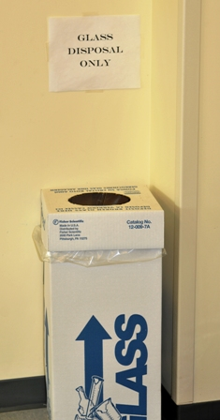
Non-chemical Waste
Broken glass can not go into the regular paper trash containers, so we have special containers for any glassware that is broken during the lab.
DO NOT PLACE PAPER IN THE BROKEN GLASS CONTAINER; it is for glass disposal
only
Do not pick up broken glass with your fingers. Use a dust pan and broom and place in the broken glass container.

Slide 28
Safety Equipment

Slide 29
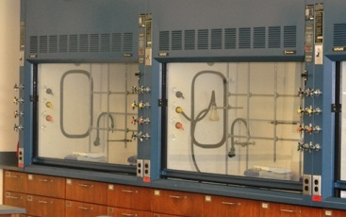
Safety Equipment-Fume Hood
Fume hoods are designed to protect you from harmful fumes, gases, and odors that may be generated during an experiment or whenever you use volatile solvents.
Any time your experiment will produce fumes, you will perform the experiment in the fume hood.

Slide 30
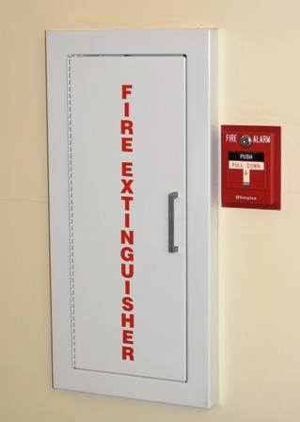
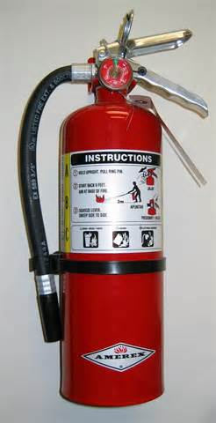
Safety Equipment-Fire Extinguisher
Every teaching and research lab in the chemistry department has a fire extinguisher.
Additionally, fire extinguishers are strategically located in the hallways on the third floor.
The website has a document that specifies the type and location of all fire extinguishers in the department.

Slide 31
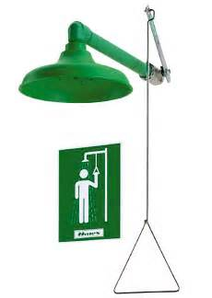
Safety Equipment-Shower
The chemistry department has four safety showers: one in the men’s restroom; one in the women’s restroom; and two in the atrium hallway, with one located between KC 337 & KC 338, and the other located outside of KC 340.

Slide 32
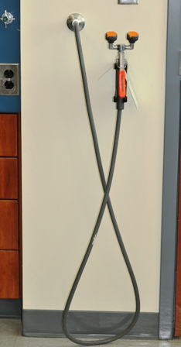
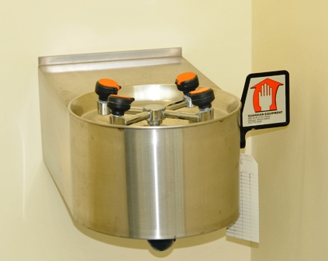
Safety Equipment-Eye Wash Station
All teaching and research labs in the chemistry department have eyewash stations in case of a chemical splash in the face. There are also eyewash stations located by the safety showers in the atrium hallway.

Slide 33
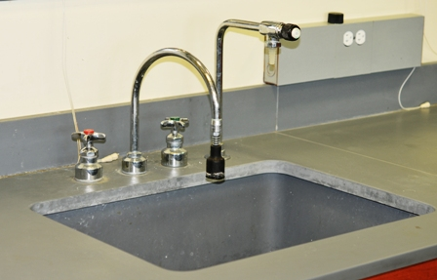
Safety Equipment-Sinks
The sink is actually the best place to wash off any solid or liquid chemical that contacts the exposed skin of the hands and arms.

Slide 34
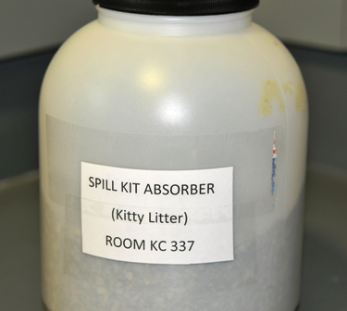
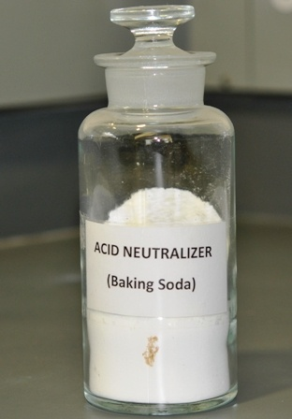
Safety Equipment-Spill Kits
To contain chemical spills, we use kitty litter as an absorbent. To neutralize acid spills we use a material such as baking soda (sodium bicarbonate).
Mercury Spill kits are available in the chemical stockroom in case of a broken mercury thermometer. However, most of our teaching labs use alcohol or spirit thermometers to minimize the risk associated with using mercury thermometers.

Slide 35
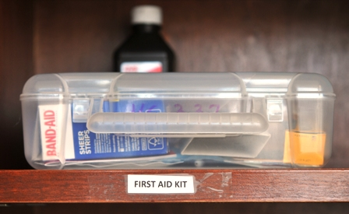
Safety Equipment-First Aid Kits
First aid kits, containing band-aids, alcohol wipes, and antibiotic ointments, are found in all the teaching labs.

Slide 36
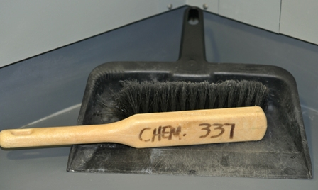
Safety Equipment-Dust Pan & Broom
To pick up broken glass or chemical spills that have been contained by kitty litter, we use a dust pan and broom.

Slide 37
Injuries and spills

Slide 38
Injuries & Spills
Always inform your instructor whenever an injury or spill occurs, no matter how minor.
Let your instructor evaluate the seriousness of the injury or spill.
All injured individuals will be advised to seek medical attention if they have any concerns over their injury.
After any injury, the UE Accident Report Form must be completed.

Slide 39
Injuries-Cuts
If the cut is minor, we will use the first aid kit to apply a band-aid. If the injury hurts sufficiently that you can’t finish the lab, then you will be escorted to Student Health for evaluation.
If the cut is serious, then immediate first aid will be given to stop or slow bleeding. In all cases, a serious cut must be attended to by medical professionals. If possible, you will be escorted to Student Health; otherwise Emergency Medical Services will be called.

Slide 40
Injuries-Burns
Chemical and thermal burns that result in a minor injury will be treated with lots of cold running water to ease pain. If you can’t complete the experiment after a small burn, you will be escorted to Student Health for further evaluation.
In all cases of significant burns, you must be attended to by medical professionals. EMS will be called for such situations.

Slide 41
Injuries-Fainting & Breathing Difficulties
If you feel faint, you will be escorted out of the lab and to a place with fresh air so that your lab instructor can evaluate your condition. Likely, you will be required to visit Student Health where you may lie down and receive further evaluation.
In all cases of breathing difficulties you will either be escorted to Student Health, or EMS will be called.

Slide 42
Spills-Liquid Chemical
Dike and cover the spill with kitty litter.
When absorbed, place litter in waste bag and seal.
Wipe down spill area with water and paper towels.
If material is hazardous, your instructor will complete a hazardous chemical label for storage and proper disposal.

Slide 43
Spills-Solid Chemical
Use dust pan and broom, but do not raise a dust.
Deposit material in waste bag and seal.
Wipe down spill area with water and paper towels.
If material is hazardous, your instructor will complete a hazardous chemical label for storage and proper disposal.

Slide 44
Spill-Mercury
Stay clear of the area where mercury is present, typically from a broken thermometer.
Let your instructor evaluate the situation and use the mercury spill kit to clean up the spill.

Slide 45
Spills-Chemicals on hands/arms
For liquid chemicals: Go to the sink and flush with water for at least 15 minutes. Do not use any material to neutralize acids or bases on your skin.
For solid chemicals: Go to the sink and first brush off excess solid with a paper towel, then begin flushing with water and continue for at least 15 minutes.

Slide 46
Spills-In Your Eyes
If a chemical splashes in your face, call for help, and go to the eyewash station and begin immediately to flush with water.
Hold your eyes open when flushing and continue to do so for at least 15 minutes.
If you are wearing contacts, flush first, then remove contacts and continue flushing with water.
Chemicals in the eye and require immediate follow-up with a medical professional.

Slide 47
Spills-Whole Body Contact
When a chemical spill over a large portion of your body occurs, you must go to the nearest safety shower.
Begin flushing with water immediately, and then take off clothing and continue rinsing for at least 15 minutes.
You will need to Student Health for evaluation after you have rinsed the chemical off your body, or EMS will be called.

Slide 48
RAMP: Principles of lab Safety

Slide 49
RAMP
RECOGNIZE HAZARDS.
Your instructor will identify for you what the chemical, physical, health, and reaction hazards are for a particular experiment.
Your job is to be aware of what these hazards are for each experiment.

Slide 50
RAMP
ASSESS THE RISKS OF THE HAZARDS
Your instructor will help to assess the risks of the hazards associated with chemicals used during the experiment.
Your job is to be understand how you might be exposed and what the probable results of exposure might be.

Slide 51
RAMP
MINIMIZE THE RISKS OF HAZARDS.
This includes employing safe work practices (e.g. appropriate PPE), good lab hygiene, use of fume hood, good housekeeping, proper handling and storage of chemical, and waste management.
For each lab you will be given specific instructions on how to properly dispose of waste generated during an experiment.

Slide 52
RAMP
PREPARE FOR EMERGENCIES.
Even though we hope that by taking the first three steps in laboratory safety to avoid fires, spills, injuries, and other emergencies, it is possible that such emergencies may happen.
You need to know the location of all the appropriate safety and emergency equipment so that you can be prepared to react to situations as they arise.

